Slide 1

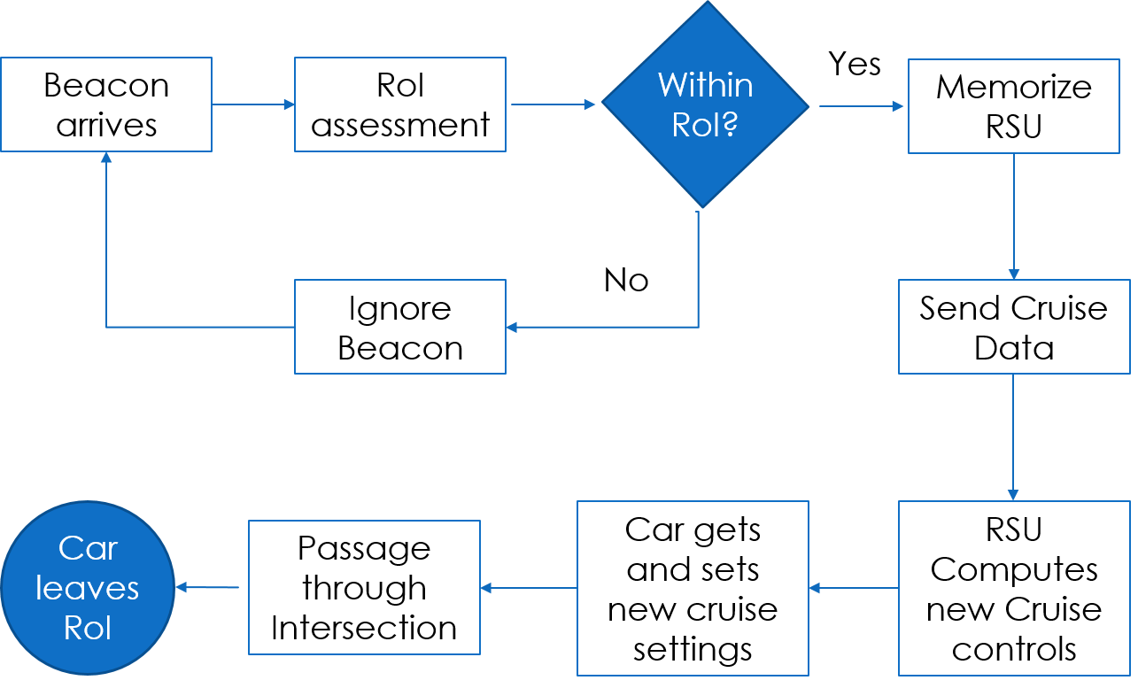
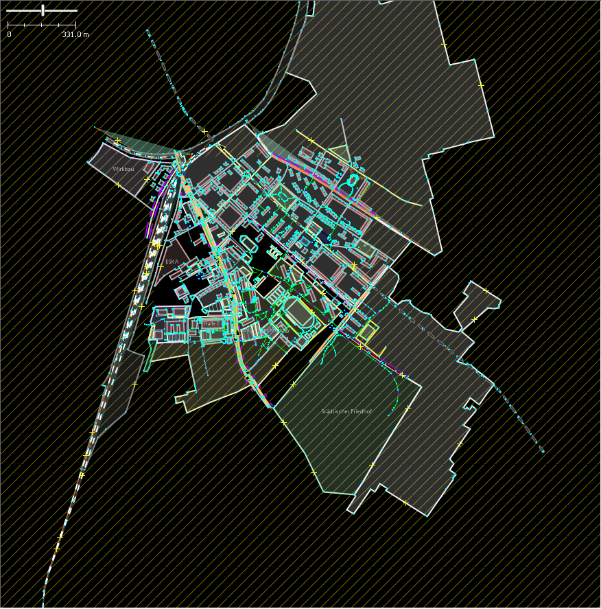
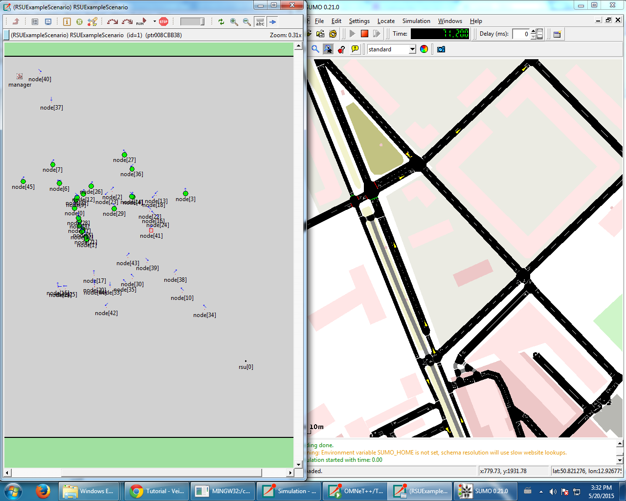
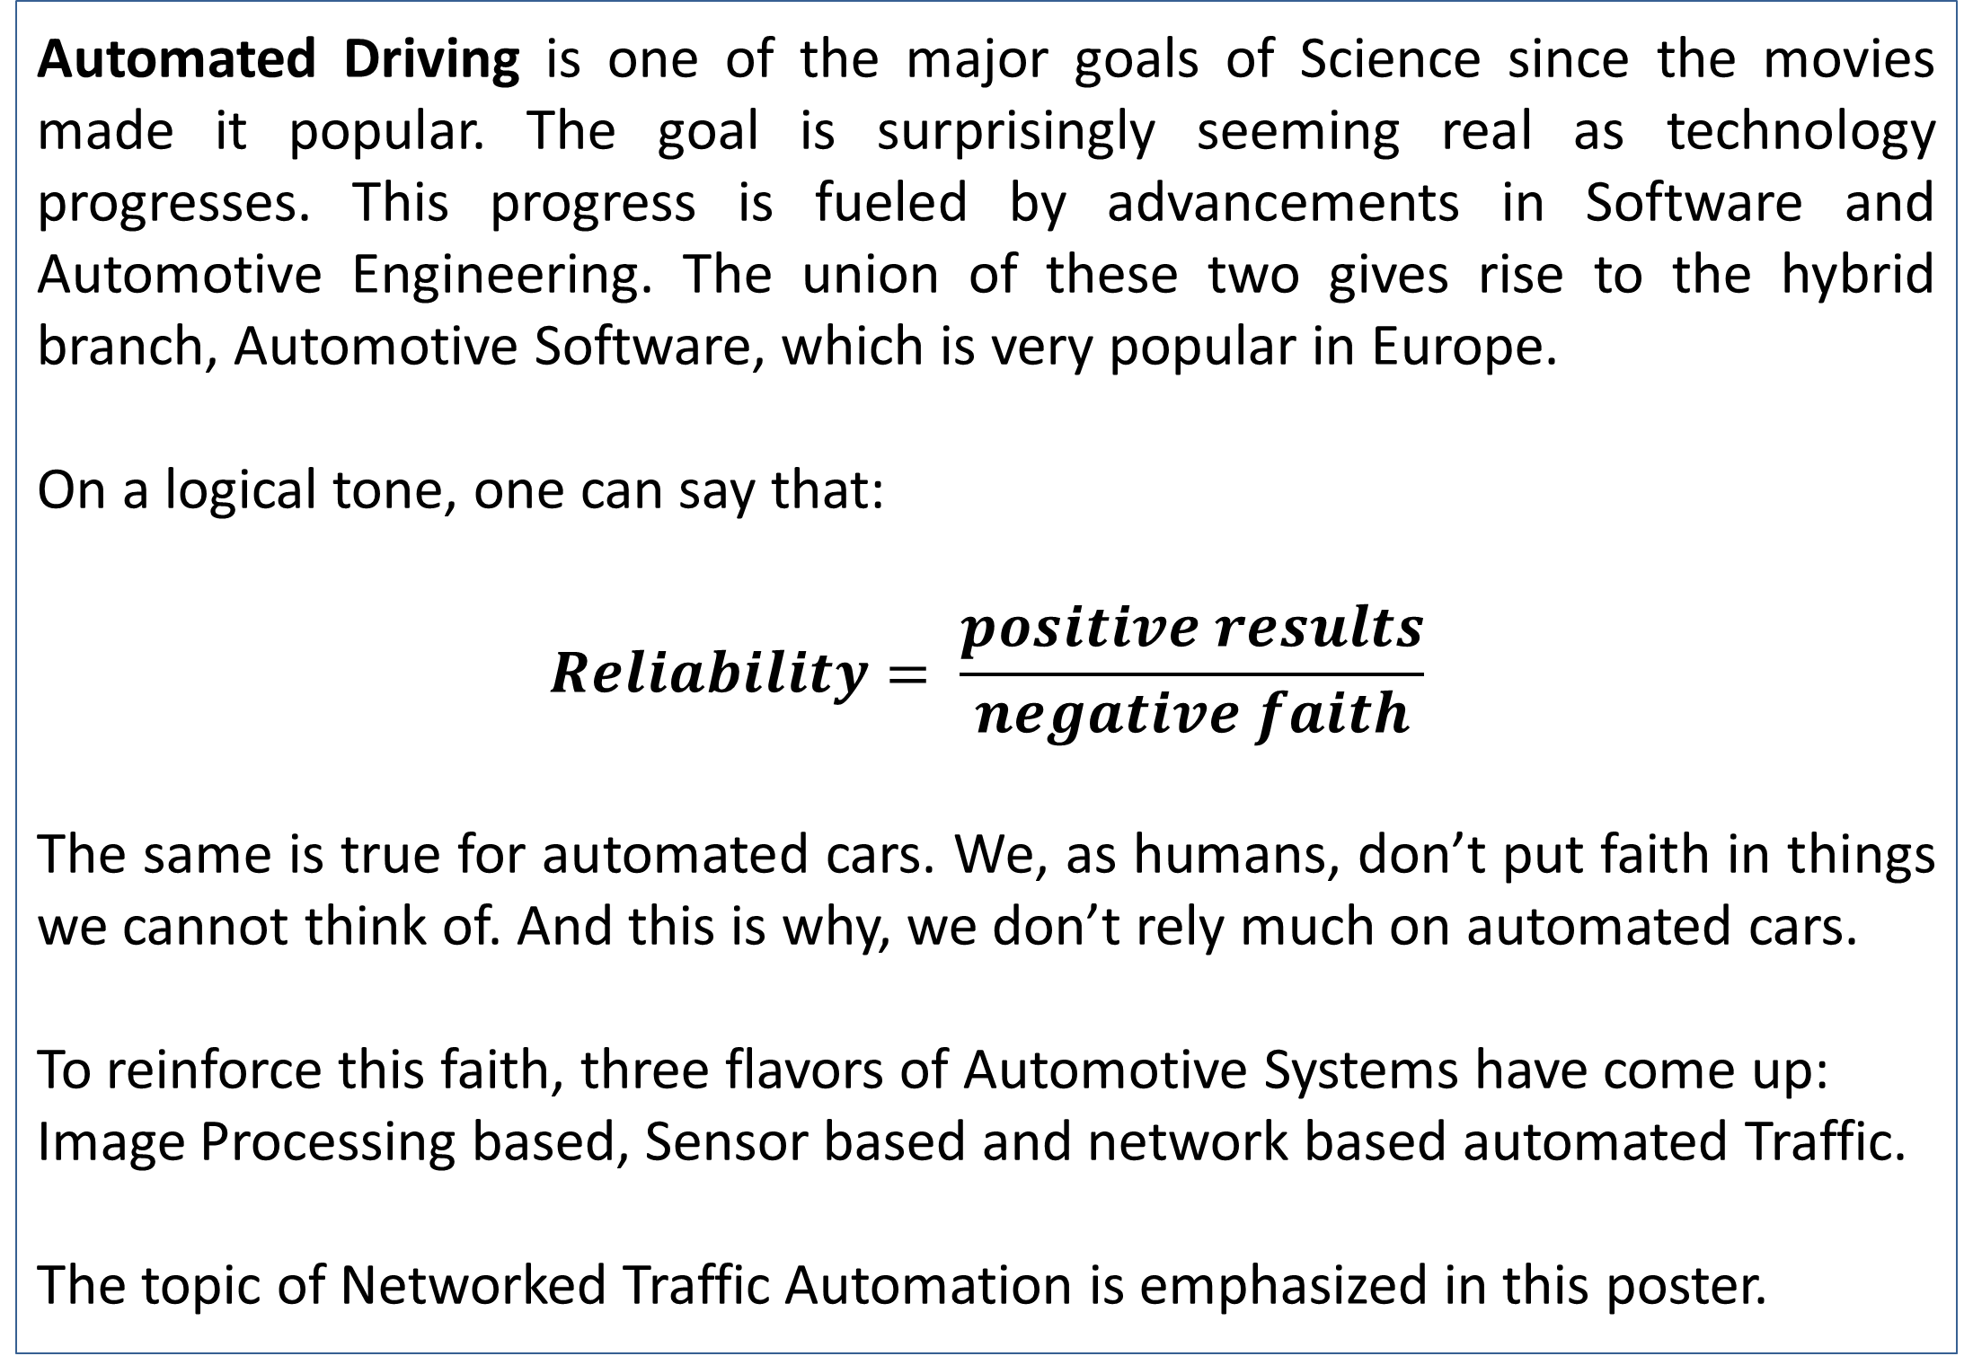
Vehicular Ad Hoc Networks and Automated Driving
Anmol Dalmia
Dept. of Computer Sc. And Engg., National Institute of Technology, Rourkela
Abstract
Vehicular Ad Hoc Networks (VANETs)
Automation in vehicles and driving is the next 'big' goal in the field of Automotive Engineering. This goal has combined the disciplines of Computer Science and Mechanical Engineering to give rise to a very new field of study- Automotive Software.
The topic for this poster is the usage of vehicular networks in vehicular automation and automotive software. It will present a small comparison between the three mentioned schema and differentiate between the mechanisms of them all but will emphasize more on depiction and creation of vehicular ad hoc networks (VANETs) and how it affects the automation of driving. Finally, it will contain a small illustration of how it can be applied to urban scenarios and how it can be used to control traffic, replacing traffic lights in the process.
VANETs are short range, strongly mobile networks that are short lived and are implemented between two or more cars. It is a broadcast network and is very sensitive. VANETs can be used for short message communication between cars, as stated by IEEE 802.11p standard.
Features are:
Short range, wave carried
Broadcast throughout the network, P2P only for short time
Highly dynamic in nature
VANETs can be used to implement collective decision making protocols for efficient traffic control automation.
Chart 1. Working Flow Chart of the proposed Traffic Control system based on RSU and VANETs
Introduction
Table 1. Comparison of Traffic Metrics based on normal Traffic Lights and VANET controlled traffic junction
Automation via Traffic Infrastructure
Automated Driving is one of the major goals of Science since the movies made it popular. The goal is surprisingly seeming real as technology progresses. This progress is fueled by advancements in Software and Automotive Engineering. The union of these two gives rise to the hybrid branch, Automotive Software, which is very popular in Europe.
On a logical tone, one can say that:
$$Reliability= \frac{positive results}{negative faith}$$
The same is true for automated cars. We, as humans, don’t put faith in things we cannot think of. And this is why, we don’t rely much on automated cars.
To reinforce this faith, three flavors of Automotive Systems have come up:
Image Processing based, Sensor based and network based automated Traffic.
The topic of Networked Traffic Automation is emphasized in this poster.
Metrics | TLS Controlled | RSU Controlled | Units
Travel Time | 52.97 | 36.31 | seconds
Vehicular Density | 3.54 | 2.43 | Veh./ km.
Lane Occupancy | 1.77 | 1.21 | %
Avg. Wait. Time at Junction | 180.10 | 0.00 | seconds
Average Speed | 9.35 | 13.64 | m/ s
CO2 Emission | 75540.4 | 74612.6 | mg/ 100 Veh.
Fuel used | 30.1 | 29.7 | ml/ trip
Automation in traffic can be achieved by the use of various traffic infrastructures. The one described in this poster is that of using an intelligent device called a Road Side Unit (RSU). Using specially designed protocols, an RSU can acknowledge the various tracks and trajectories of incoming cars to an urban traffic junction and can direct them the required cruise controls for a safe and efficient passage. Simulation runs on this system are shown in Figure 1.
This is a huge advantage over traditional Traffic Light based Systems (TLS) where only a few cars can move at a time from a single lane. The automotive software for these systems are of layer based architecture and have super-polynomial performance.
A simple model is tested with statistics in Table 1; method illustrated above.
Tests, Comparisons and Results
The results of a test run based on RSU based and TLS based traffic control units at an urban road junction or crossing are presented below. The run was made for 500 cars coming inwards to the junction from 4 bi- lanes. Each car was at a speed of 50 kmph, the maximum allowable speed in German roads at right handed traffic setup.
The results depict that due to efficient usage of the road junction, most of the negative traffic metrics such as pollution and waiting time have reduced to a certain level, giving a heads up to the model.
The drawback here is that such systems assume that the cars are automatically controlled, ie, the cars have automatic cruise controls. This situation isn’t expected to be possible in the near future. Moreover, once cruise controls are set, the system assumes no bias or fault on the cars’ part, which is hyperbolic as well.
Nevertheless, the test results illustrate the point well as shown in Table 1.
Conclusion
From the test results presented, it is clear that automated traffic systems provide much better efficiency values than normal traffic light based systems.
The main problems behind slow propagation of such systems are:
Cost incurred due to exclusive hardware and policy implements
Skepticism due to automation involved
Economic conditions of the nation
It is expected that in the coming years, automated cars will take over manually driven cars as the performance bar rises up and up and resource conservation catches momentum. Till then, it’s a matter of time.
Figure 1. Simulation runs on RSU based systems with Real World Traffic Density in Chemnitz, Germany
Submitted by:
References
Anmol Dalmia
712CS2043
Seminar and Technical Writing
“Simulation of vehicular ad-hoc networks: Challenges, review of tools and recommendations”, Razvan Stanice, Emmanuel Chaput, Andre-Luc Beylot. Elsevier
“Car-to-X Communication in Heterogeneous Environments”, Christoph Sommer. Doctoral thesis, Erlangen 2011
“A multi-channel IEEE 1609.4 and 802.11p EDCA Model for the Veins Framework”, David Eckhoff, Christoph Sommer. ACM/ ISCT International Conference on Simulation Tools and Techniques for Communications, Networks and Systems (SIMUTools 2012)
“Fairness Kills Safety: A comparative Study for Intersection Assistance Applications”, Stefan Joerer, Bastian Bloessl, Michael Segata, Christoph Sommer, Renato Lo Cigno, Falko Dressler. 2014 IEEE 25th International Symposium on Personal, Indoor and Mobile Radio Communications
“A Vehicular Networking Perspective on Estimating Vehicle Collision Probability at Intersections”, Stefan Joerer, Bastian Bloessl, Michael Segata, Christoph Sommer, Renato Lo Cigno, Falko Dressler. IEEE Transactions on Vehicular Technology, May 2014

